Slide 1
School Health Advisory Board
2011 - 2013

Slide 2
Homework
Families report stress due to homework
Evidence that volume of homework does not correlate with improved performance until secondary school, in fact sometimes diminishes academic performance
Families report adolescent sleep deprivation due to homework & extracurricular activities

Slide 3
Too Much?

Slide 4
Homework and Stress
Pediatricians are concerned that too much homework and too little play may be causing a generation of students showing increased signs of depression and anxiety as well perfectionism and stress*
Stress from homework can cause release of stress hormones which are associated with sleep deprivation and chronic illnesses
*2007 Report of American Academy of Pediatrics Committees on Communications, and Psychosocial Aspects of Child and Family Health Pediatrics January 2007

Slide 5
Stress and Homework

Slide 6
Homework and Stress

Slide 7
Health Effects of Sleep Deprivation
Sleep deprivation linked to:
Childhood weight gain and obesity
Increased athletic injuries
Decreased alertness and other key functions related to academic success
Less ability to regulate emotions and limit restless-impulsive behavior in school
* American Academy of Pediatrics

Slide 8
Sleep Deprivation

Slide 9
Homework Recommendations
Homework should supplement/enhance
Be appropriate to developmental stage
Standards: 10 minutes per grade per night
Upper levels – coordinate with other teachers
Consider disciplines having particular days for unit tests & teacher coordination so not all big assignments are due simultaneously
Provide teacher training on developing meaningful homework assignments
Consider homework-free holidays including summer

Slide 10
More of This

Slide 11

Less of This

Slide 12
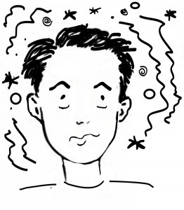
Concussion

Slide 13
Concussion
The Board recommends:
Continued support of concussion plan
Continued communication with community health care providers in to ensure consistent approach
Consider purchasing Headminder Concussion Resolution Index for ease of use on the sideline and by health care providers

Slide 14
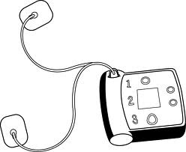

AEDs

Slide 15
AEDs
AED units are in all middle and high schools
Recommend consideration of units for elementary schools
- AED ($1,119 - $2,500)
- Cabinet ($165 - $200)
- Pads ($65) replace every 2 years and after use
- Battery ($164) replace every 4 years

Slide 16

School Nurses

Slide 17
School Nurses
Remain busy seeing 167,100 clinic visits SY 2011 – 2012
2,303 students with diagnoses of chronic conditions such as diabetes, seizure disorders and life-threatening food allergies
Food and sting allergy diagnoses up 75% since 2008 to 271
Recommend continued staffing with consideration of increasing part-time nurses to full-time
Recommend granting time for trainings, meetings and continuing education

Slide 18
Epinephrine
In accordance with new legislation, all schools now have stock injectable epinephrine for use with students believed to be having anaphylactic reactions
At least two staff members at each school are trained to recognize and respond to anaphylaxis

Slide 19
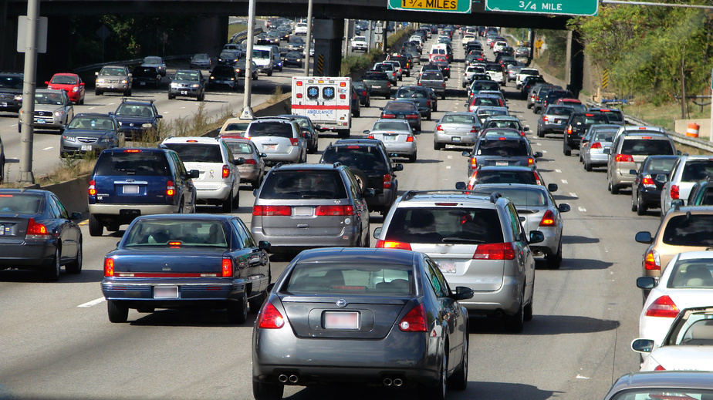
Concern for Schools in Path of Proposed Bypass

Slide 20
Studies on Health Effects of Vehicle Emissions Show:
Relationship between chronic low-level traffic-related air pollution exposure and neurobehavioral function and development
Traffic-related pollution exposure at school and homes may both contribute to the development of asthma and other airway reactive disease
Pollution-related asthma exacerbations among children living near roadways
Exposure to traffic-related air pollution can raise pregnant woman’s risk for preeclampsia

Slide 21
Recommend
Request these concerns be addressed in VDOT’s Supplemental Environmental Impact Statement
Request consideration of locating by-pass at least 500 meters from school campuses

